Slide 1
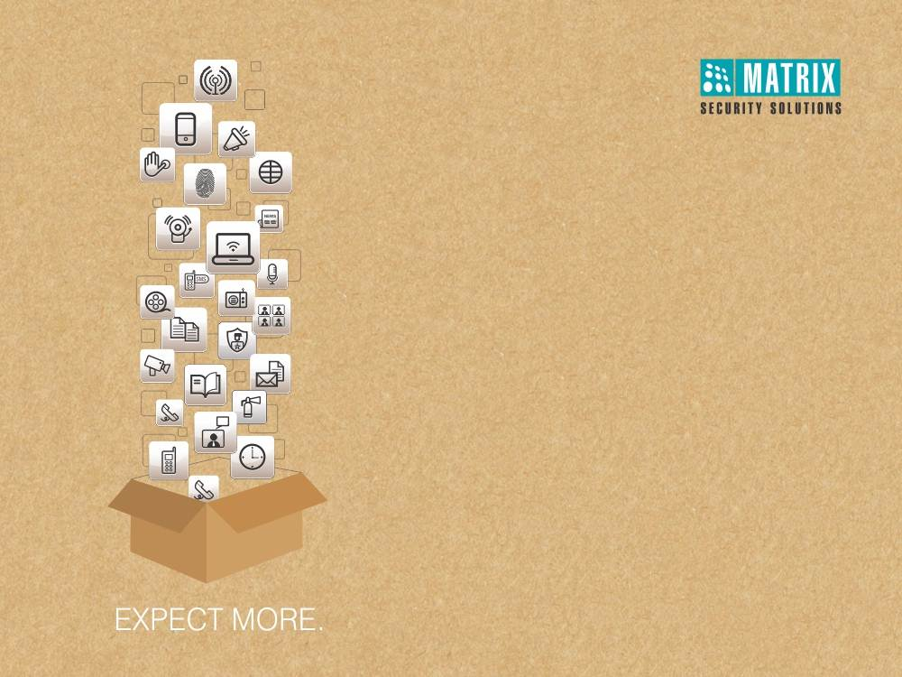
Matrix People Mobility Solution
Right People in Right Place at Right Time
Notes:
Self Introduction.

Slide 2




How Unmanageable People’s Movement Affect your Organization?
Productivity Reduction due to Inaccurate Attendance Management
Using Traditional Attendance Management Method
Error Prone Employee In-Out Time Data
No Mechanism to Track Break Hours
Security Threats in Key Areas
Using Traditional RF Card based Access Control
Very basic Access Control with Limited Features
Reactive Access Control
Employee Dissatisfaction with Error Prone Salary Calculation
Manual Attendance and Leave Calculation for Salary Data
Long Payroll Calculation Time with Errors
Decentralized Attendance Data

Slide 3
What Solutions we Offer?
Notes:
We observed that client finds difficult to manage different hardware and software providers. Hence,
We have our own H/w and S/w solution.
We provide complete Enterprise solution.
One stop solution
Introduced Unique Platform that has unique features which will see in further slides.

Slide 4





What is Matrix COSEC Solution?
A Comprehensive Solution for
Enterprises, SME and SOHO
Multiple Credentials
Palm Vein, Fingerprint and RFID
A Complete Solution with
Hardware and Software
Integrated Solution
3rd Party Hardware and Software Integration
A Solution having
Flexibility, Scalability and Modularity

Slide 5





How We can Help You?
Increase Productivity
Automate Attendance
Process
Increase Security
ERRORS
Reduce Payroll
Errors
Reduce Cost
Higher Employee
Satisfaction

Slide 6
How our Offerings are Different?

Slide 7
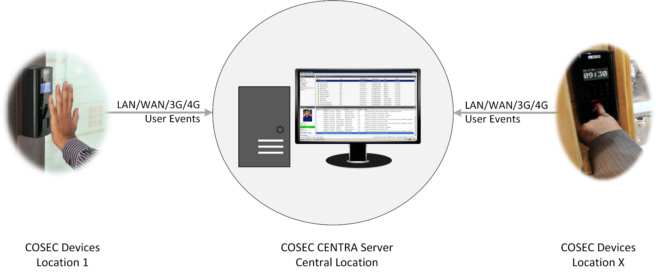
Real Time Data Transfer to Server
Data Transfer from Device to Server in <1 Sec
Auto Push Technology
No Need to Download Manually
Notes:
Push Technology – If the devices are not IP then you have to install a server at all different locations and it would cost more. Whereas with IP based controllers you just need to have a COSEC Platform with which the devices communicated directly with the server on Real Time basis and it also saves the cost.
Also, in push technology the devices constantly communicates with the server.

Slide 8

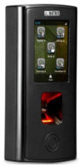




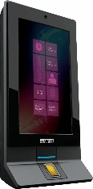

Automatic Fingerprint/Palm Template Distribution
LAN/WAN/3G
Enrollment from Location 1
COSEC CENTRA Server
Location 2
Location X
Location 3
Distribution from COSEC Server
No Need to Enroll Again on other Locations

Slide 9
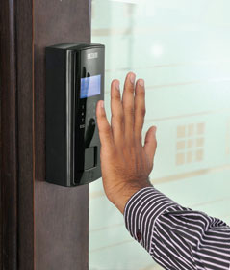


Real Time Notification
‘Your Tour is Approved’
Email
LAN/WAN/3G
Events
‘Out Punch is Missing’
SMS
COSEC CENTRA Server
SMS and Email Notification
To User or Reporting Officer
For Attendance, Leave and Access Related Notification
Notes:
There are total 40 events on which alerts can be sent.
Give short example of Dubai Case study.

Slide 10









Scheduler Services
Attendance Report
(Department – 2)
HR/HOD
Attendance Report
(Department – 1)
Shifts
Leave Credit
COSEC CENTRA
Server
Automated Backup
Employees
Admin
Notes:
Schedule services mainly useful for
HR / Admin – reports generation
IT – for offline devices and backups
Employees – to check their daily attendance.
Third party Integration – Export data template in Excel.

Slide 11




Multiple Connectivity
2G/3G/4G
Wi-Fi
Ethernet/PoE
USB

Slide 12
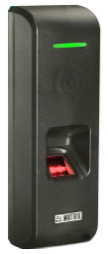


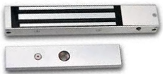
Common Power Supply to Drive 3 Devices
Power Adaptor
Exit Reader
or
PoE Switch
COSEC Door Controller
Door Lock
Notes:
Power Adaptor – Device giving power to all the other attached devices such as Exit Reader, Door Lock and Exit Switch.
If the device is powered up with PoE then it can power all other devices and door lock upto 650 lbs.

Slide 13
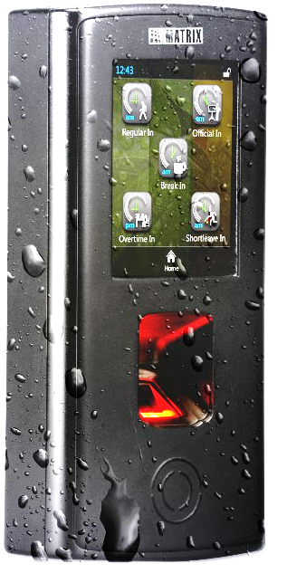
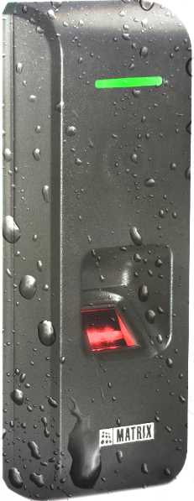
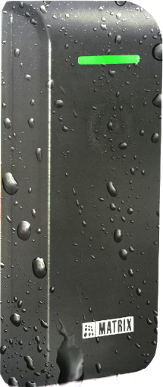
IP65 Design
Benefits of IP65 Certifications
Resistant to Dust
Level of Protection from Liquid
Suitable for Weather Proof Installations
IP65 Certified Products
COSEC VEGA
COSEC PATH

Slide 14
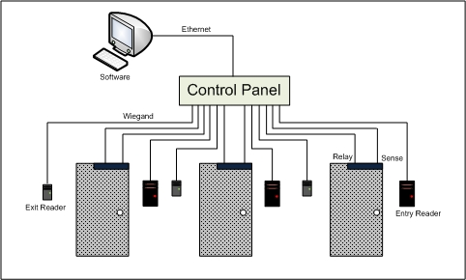
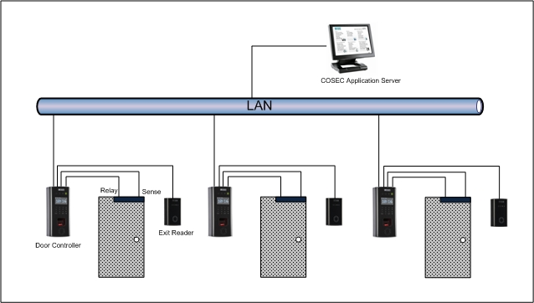
COSEC Architecture
Conventional Systems Centralized Connectivity
Matrix COSEC
Distributed Connectivity
Notes:
1. Wiegand Vs. IP
2. Flaws of Traditional Architecture.
- wiring issue
- Stability
- Cost and Centralised connectivity
- Our Device is a mini computer. It has its own processing power and storage.
3. Built- In reader controller.

Slide 15




COSEC Architecture Benefits
Scalable in the Smallest Factor of One Door Controller
Protect Investment
Standard CAT5-CAT6 Wiring
Reduce Cabling Cost and Maintenance Cost
Standalone Independent Device Architecture
Improve Network Reliability and Performance
Plug and Play Device
Easy and Fast Installation

Slide 16



Fingerprint Templates
10 Fingerprint Templates per User
9600 Fingerprint Templates
Dual Template to Reduce Rejection

Slide 17
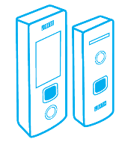
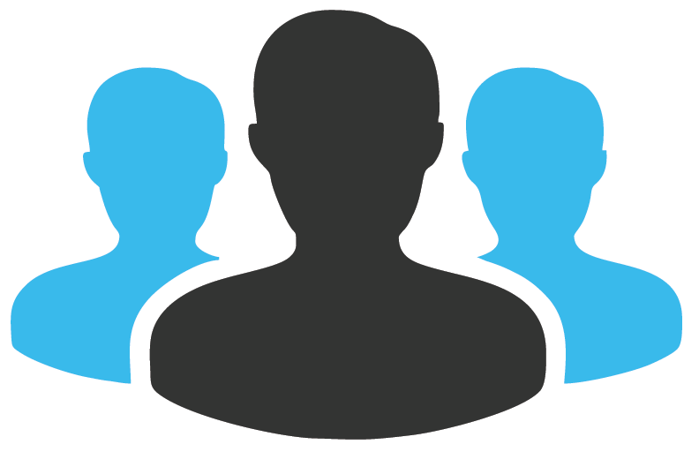


Scalability and Flexibility
65,000 Devices
1 Million Users
Add Software Modules based on Requirements any Time
Web based- Access from Anywhere

Slide 18
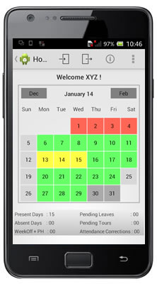

Mobile Application
Mobile Application for Employees and Managers
Mark Attendance from Mobile
Track Attendance Using GPS
View Attendance and Leave Details

Slide 19






Customized Reports and Charts
200+ Reports and Charts
Customized Report Generation
Apply Filters to Generate Specific Report
Reports in
MS-Excel
MS-Excel Data
PDF
XML
Rich Text Format
RTP
MS-Word
MS-Word Editable

Slide 20
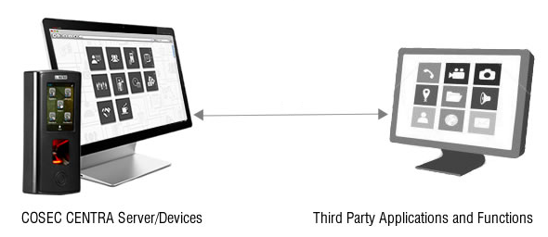
Integration with 3rd Party Software
Integration Using | Integration with
Database to Database API Offline Export | Payroll ERP HRMS Active Directory

Slide 21

Our Prestigious Customers

Slide 22



Our Prestigious Customers
BFSI
Government
Gruh Finance Ltd
Reserve Bank of India
Sri Ram Finance
NBQ Bank (UAE)
Mahindra Finance
Vijaya Bank
Money Matters Securities Pvt Ltd
MF Global
State Bank of India
Surat Peoples Co-Operative Bank
Islamic Development Bank (Iraq)
Mahindra & Mahindra Finance
Power Grid
Indian Air Force
Ahemednagar Municipal Corporation
Bhartiya Rail Bijlee Company Ltd.
Special Task Force, Kolkata Police
Bharat Heavy Electricals Ltd (BHEL)
GNFC
Ministry of Finance (Indonesia)
Baroda District Court
DRDO
National Library (Vietnam)
Ministry of Works (Bahrain)

Slide 23


Our Prestigious Customers
Manufacturing
Construction
Adani Enterprises Ltd
Khimji Ramdas (Oman)
TATA Steel Ltd
Tyco Electronics
Aujan Industries Co (KSA)
Linde Engineering India Pvt Ltd
Reliance Industries Ltd.
Finolex Power Systems Pvt Ltd
Woodland Limited
Schneider Electric India Pvt Ltd
L'oreal India Pvt Ltd
VIP Industries Ltd
Sterling and Wilson Ltd
Shapoorji Pallonji Co. Ltd
Raheja Atlantis
Parshwanath Builders
Rustomjee
Reward Constructions Pvt Ltd
L &T (Kolkata)
Shubhkamna Buildtech Private Limited
Al-Khodari Sons Co (KSA)
Al Majdouie Group (KSA)
Apex Real Estate (UAE)

Slide 24


Our Prestigious Customers
Pharma & Health Care
IT & Services
Micro Labs Ltd
Alkem Laboratories Ltd
Dr. Reddy’s Foundation
Surien Pharmaceuticals Pvt Ltd
Rottapharm Co. Ltd. (Thailand)
Biotech Vision Care
Fortis Memorial Research Institute
Gold’s Gym
Viva Gym (South Africa)
Appllo Hospital
Riaz Medical Center (Sharjah)
Al Kamal Pharma & Medical Services (KSA)
Fedex (Bangladesh)
Blue Dart Express Ltd
Real Image Media Technologies (P) Ltd
TCI
First Flight Couriers Ltd
Matrimony
TATA Consultancy Services Ltd
You Broadband India Pvt Ltd
Wipro Ltd
Collabera Technologies Pvt Ltd
CMC Limited
Dozco India (P) Ltd

Slide 25

Our Prestigious Customers
Education
Other Sectors
Euro Kids
DPS
Pune University
MIT, Pune
Presidency Group of Colleges
Rishikul Vidyapeeth
Indian Institute of Science, Karnataka
Madanapalle Institute of Technology & Science
British School
Peterhouse Group of Schools (Zimbabwe)
Centrum Printing (Australia)
Kuwait Oil Company (Kuwait)
Rabigh Refining & Petrochemical Co. (KSA)
Khaleej Times (UAE)
Rotana Jet Aviation (Abu Dhabi)
Mccain Food (India) Pvt Ltd
Bhutan Fruit Product Pvt Ltd
Suguna Foods Limited
Sarovar Hotel and Resorts
Chennai Silks
Hotel Fern

Slide 26
Matrix COSEC Solution

Slide 27
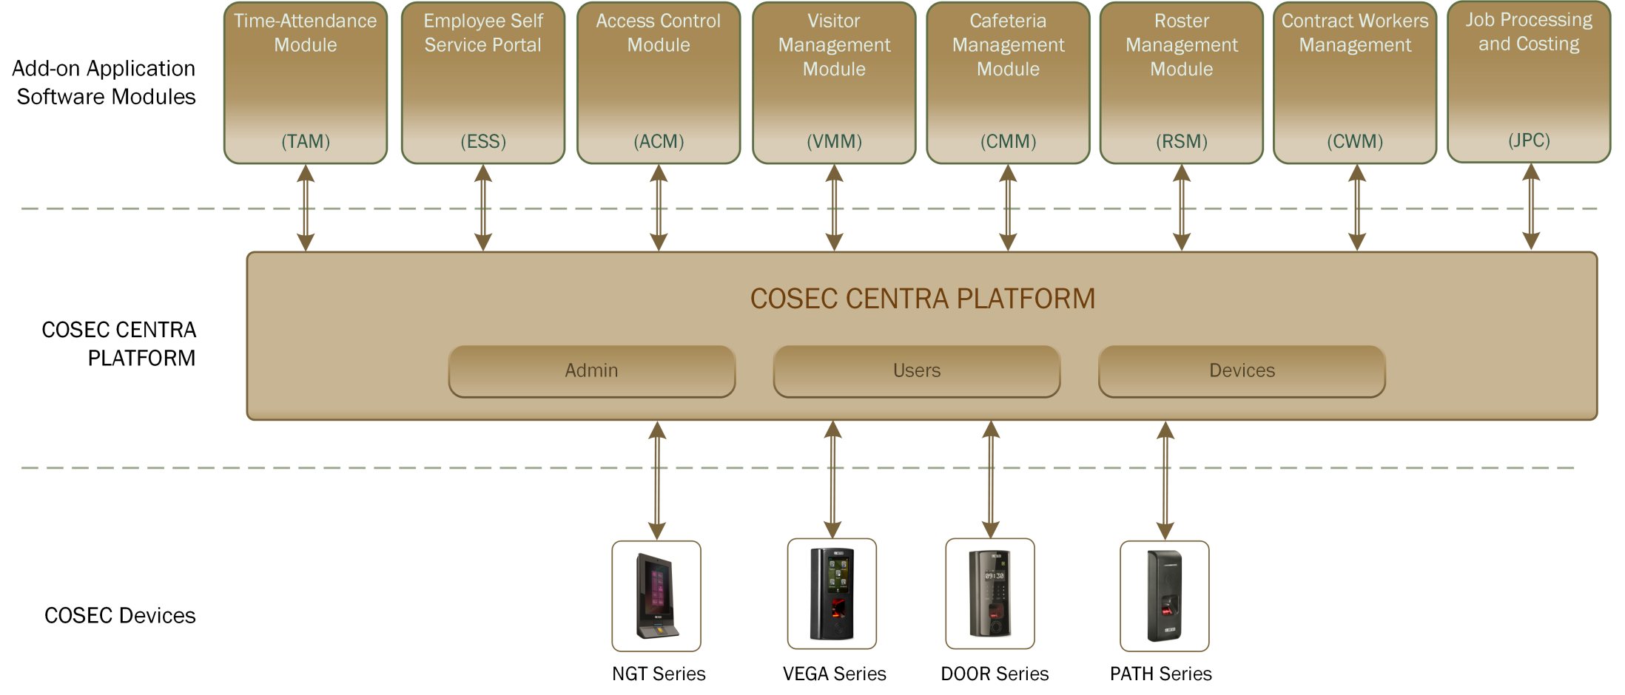
Solution Architecture
* Please check for availability of “JPC” Add-Ons
Notes:
We observed that client finds difficult to manage different hardware and software providers. Hence,
We have our own H/w and S/w solution.
We provide complete Enterprise solution.
One stop solution
Introduced Unique Platform that has unique features which will see in further slides.

Slide 28
COSEC Solution
Devices
Application Software
Door Controllers
PLATFORM
Access Control Panel
Add-on Modules
Readers

Slide 29
Matrix COSEC Door Controllers

Slide 30

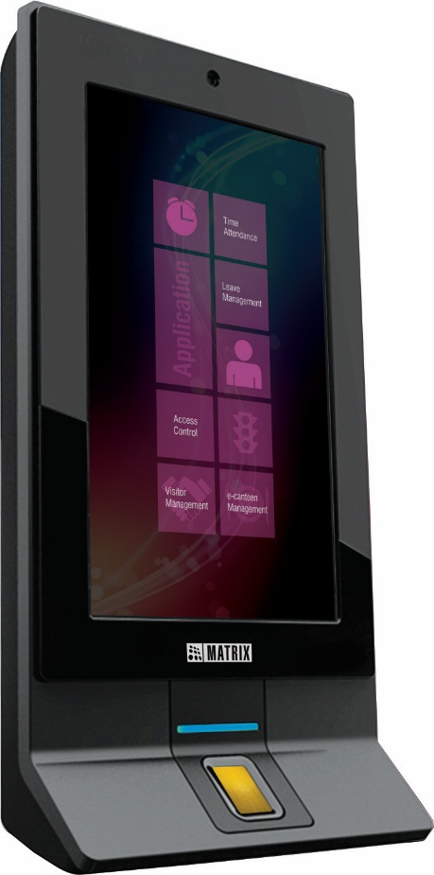
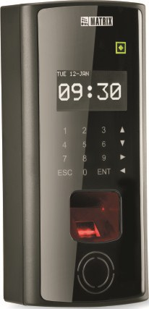
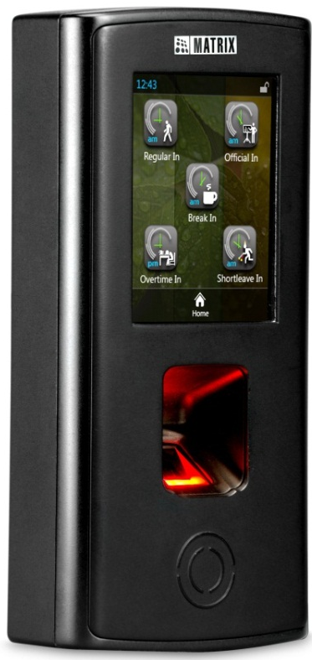
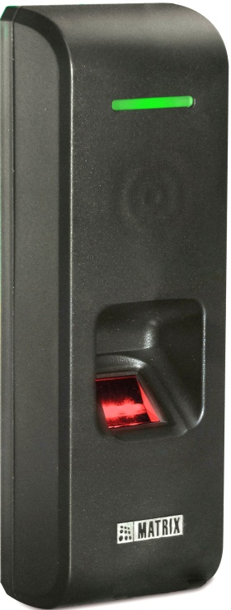
Standalone Door Controller
Time-Attendance and Access Control
DOOR Series
PATH Series
VEGA Series
NGT Series

Slide 31



DOOR Series
With Fingerprint and RFID Card
COSEC DOOR FOP
COSEC DOOR FOT
Access Control and Time-Attendance
Time-Attendance

Slide 32
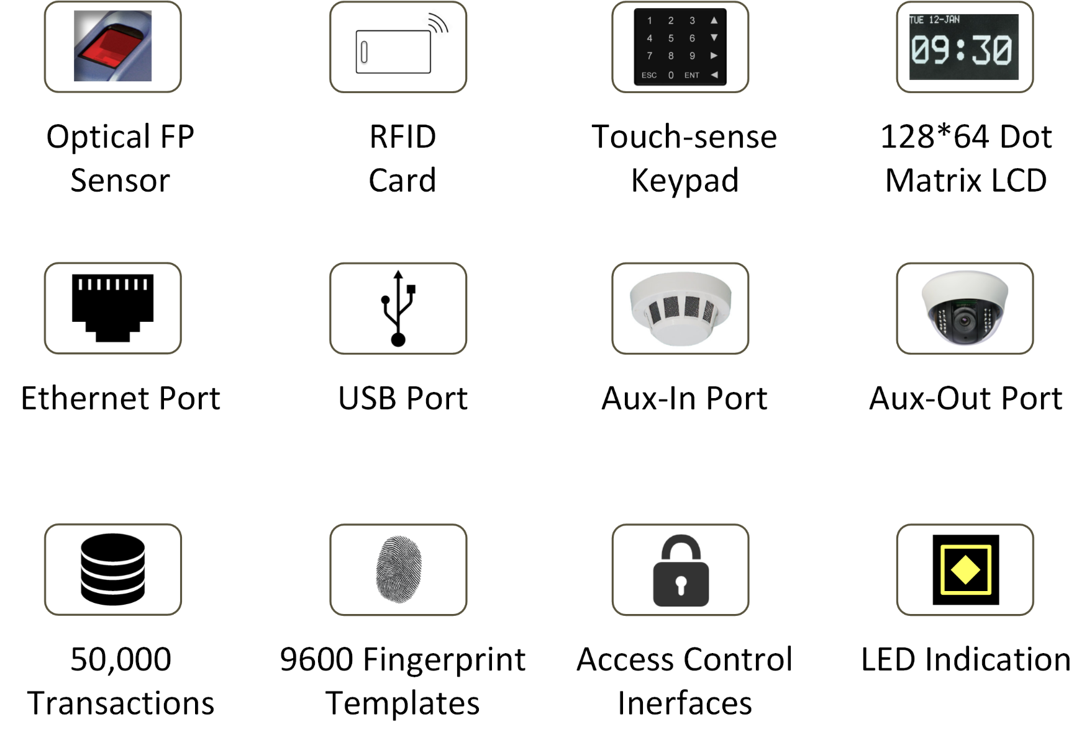
DOOR Series - Key Features

Slide 33
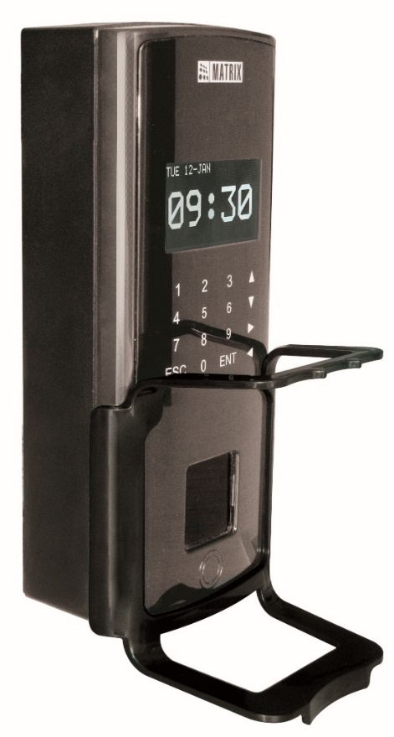
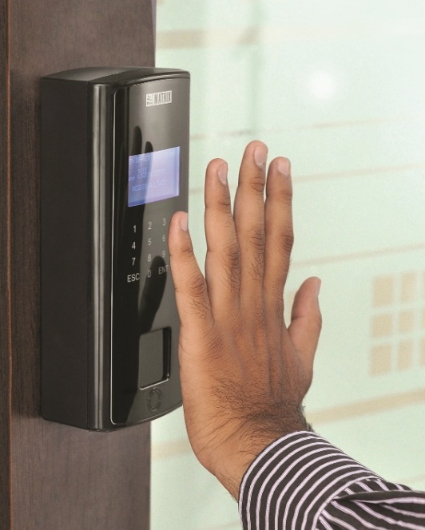

DOOR Series
Palm Vein based Door Controller
COSEC DOOR PVR
Access Control and Time-Attendance

Slide 34
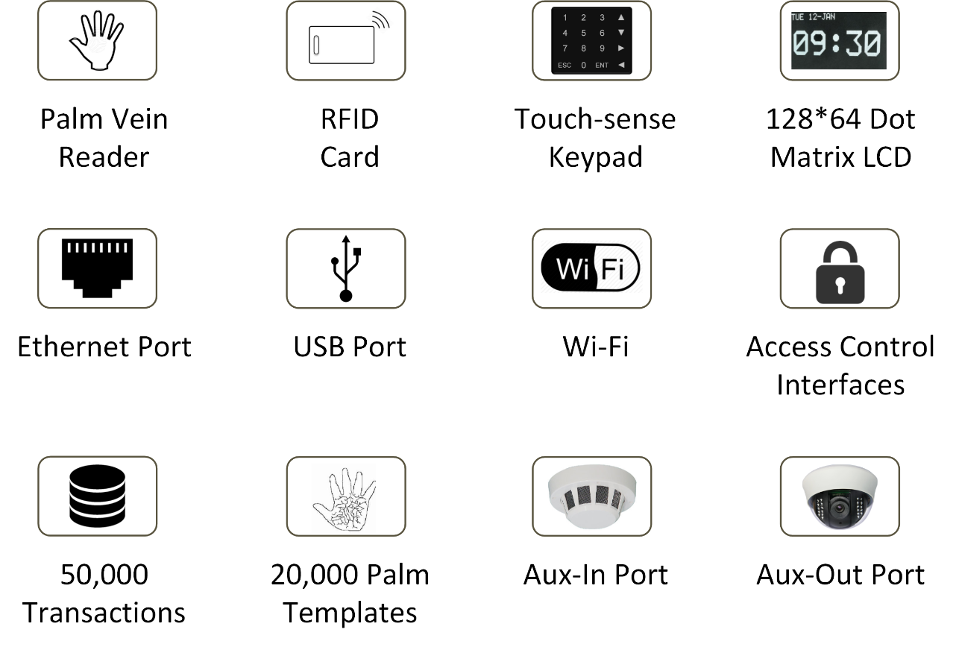
DOOR PVR - Key Features

Slide 35
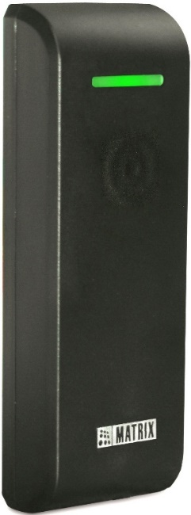
PATH Series
With Fingerprint and RFID Card
Where X=
E: EM PROX
M: Mifare
I: HID iCLASS
P: HID PROX
COSEC PATH DCFX
COSEC PATH DCCX
Fingerprint and Card
RFID Card
Access Control and Time-Attendance

Slide 36
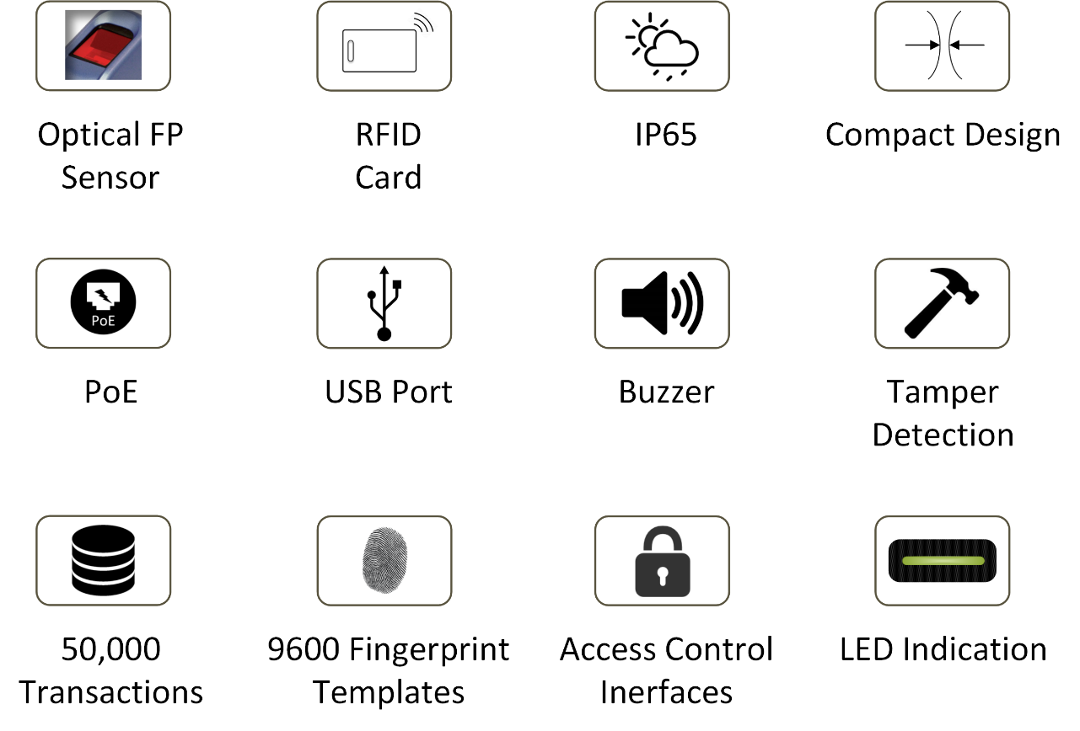
PATH Series - Key Features

Slide 37

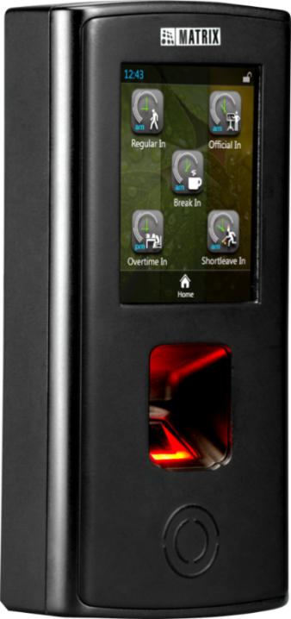
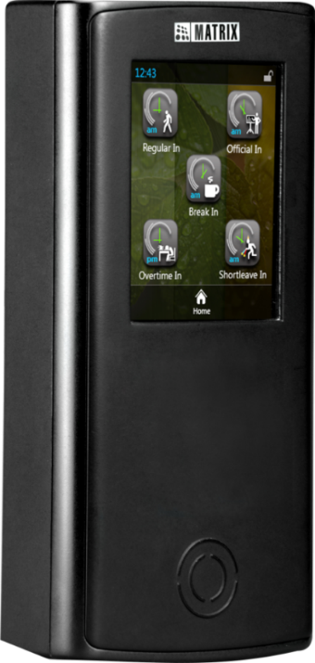
VEGA Series
With Fingerprint and RFID Card
COSEC VEGA FAX
COSEC VEGA CAX
Fingerprint and Card
RFID Card
Access Control and Time-Attendance

Slide 38
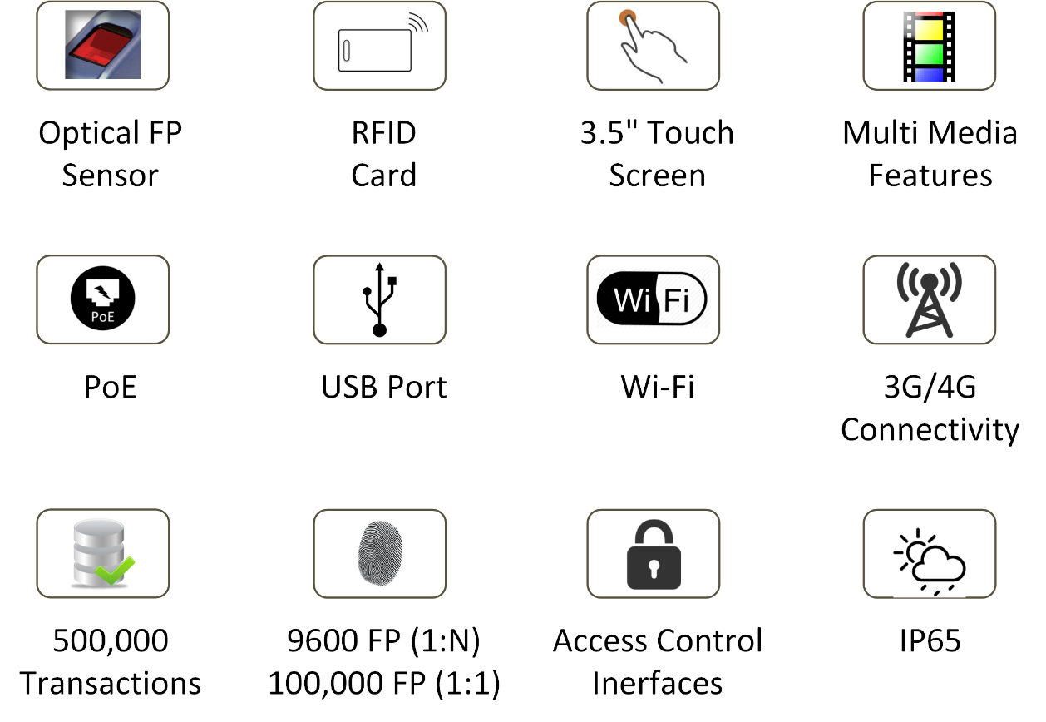
VEGA Series - Key Features

Slide 39


NGT Series
With Fingerprint and RFID Card
COSEC NGT FCX
Access Control and Time-Attendance

Slide 40
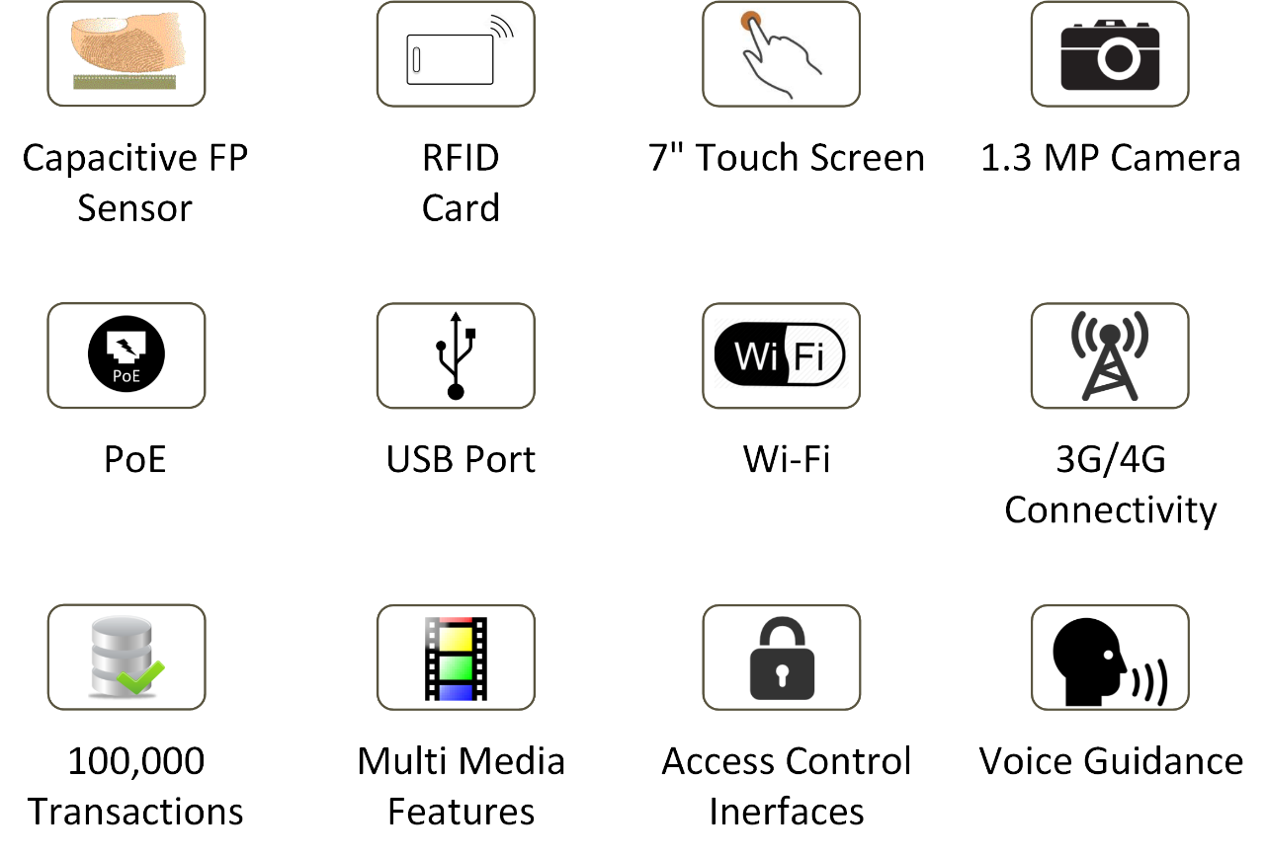
NGT Series - Key Features

Slide 41
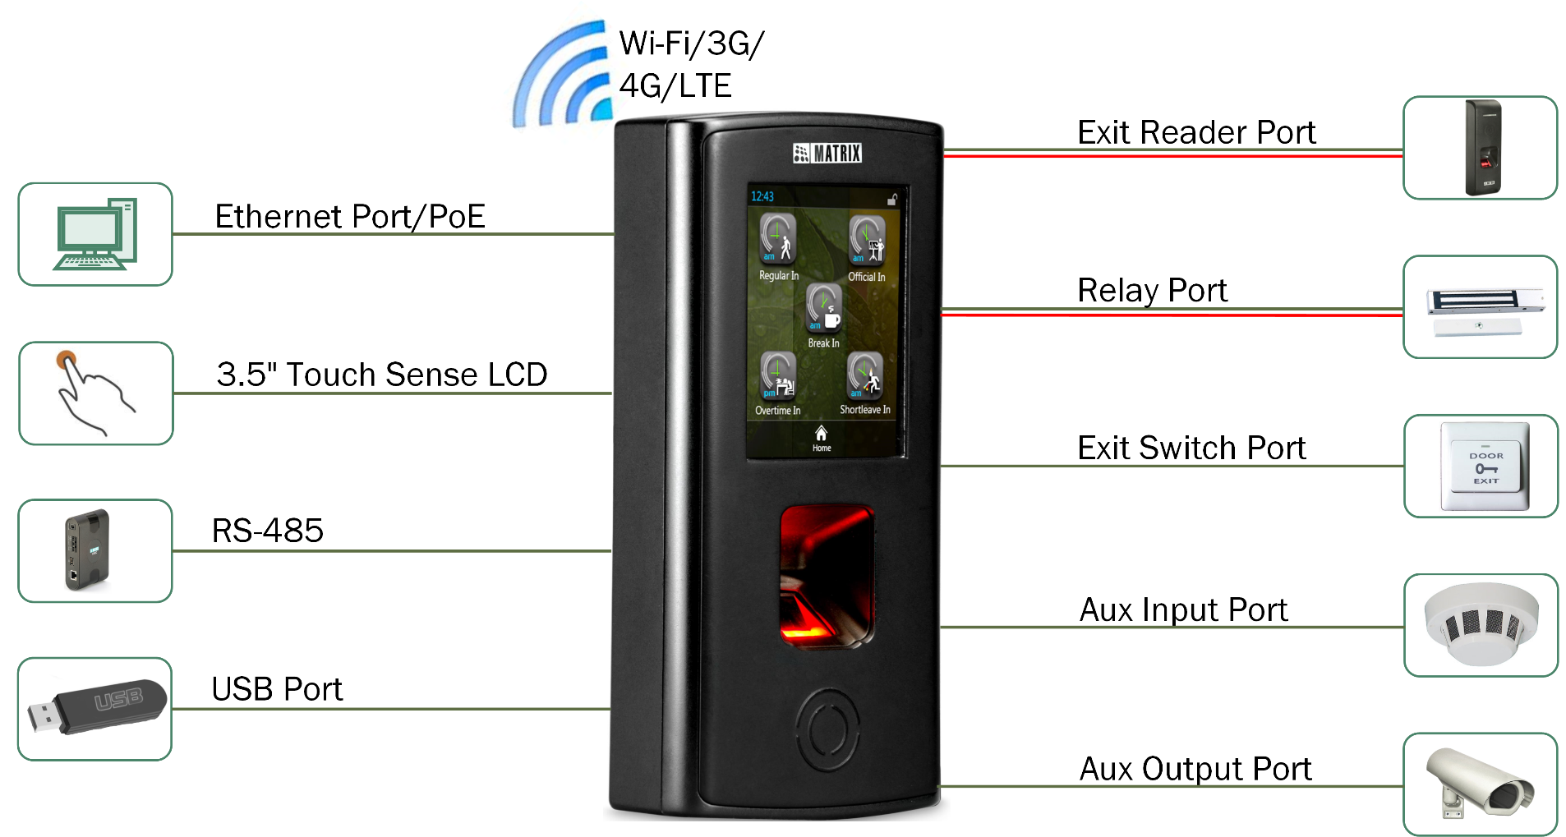
COSEC Door Controller Interfaces

Slide 42
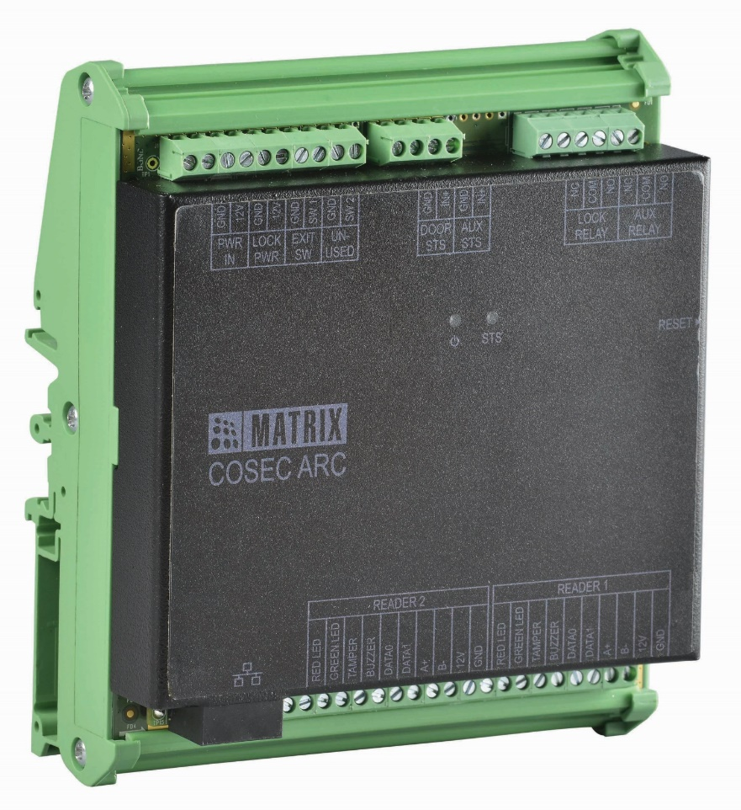
Single Door Controller
Access Control and Time-Attendance

Slide 43

COSEC ARC
Single Door Panel
COSEC ARC DC100P
COSEC ARC DC100S
With PoE
With RS-485
Access Control and Time-Attendance

Slide 44
COSEC ARC - Key Features
Compact, Single Door IP Panel With PoE
Operation Modes:
  Standalone Mode With COSEC PANEL or
  Network Mode with COSEC CENTRA
2-Readers on Wiegand or RS-485
Support Data and Power on PoE for Readers and Door Lock
10,000 Users and 1,00,000 Events Support
Aux-In and Aux-Out Port
Din Rail and Box Mounting

Slide 45
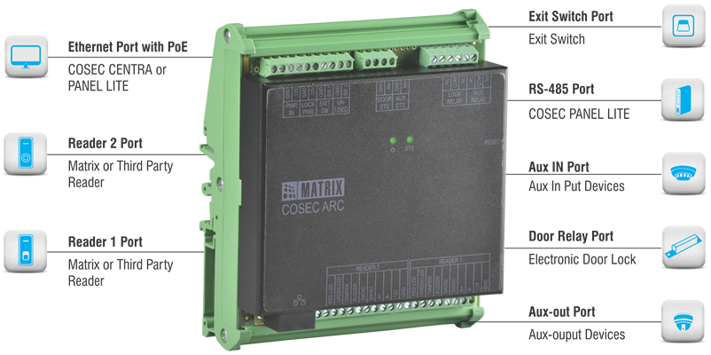
COSEC ARC Interfaces

Slide 46
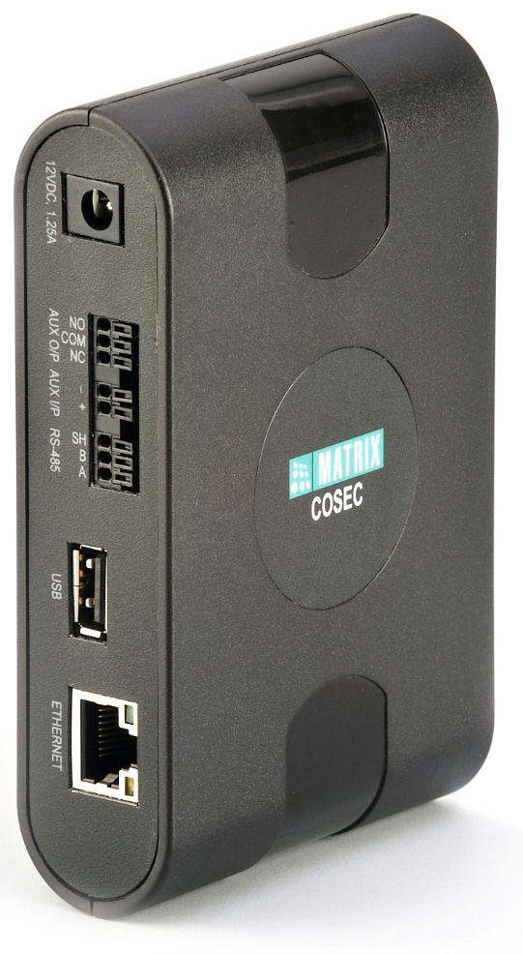
Access Control Panel

Slide 47
Access Control Key Features
Control 255 COSEC Door Controllers
Operation Modes:
  Standalone Mode With Built-In Software
  Network Mode with COSEC CENTRA
Ethernet and RS-485 Connectivity
USB Port for Wireless Connectivity
25,000 Users and 5,00,000 Events Support
Aux-In and Aux-Out Port

Slide 48
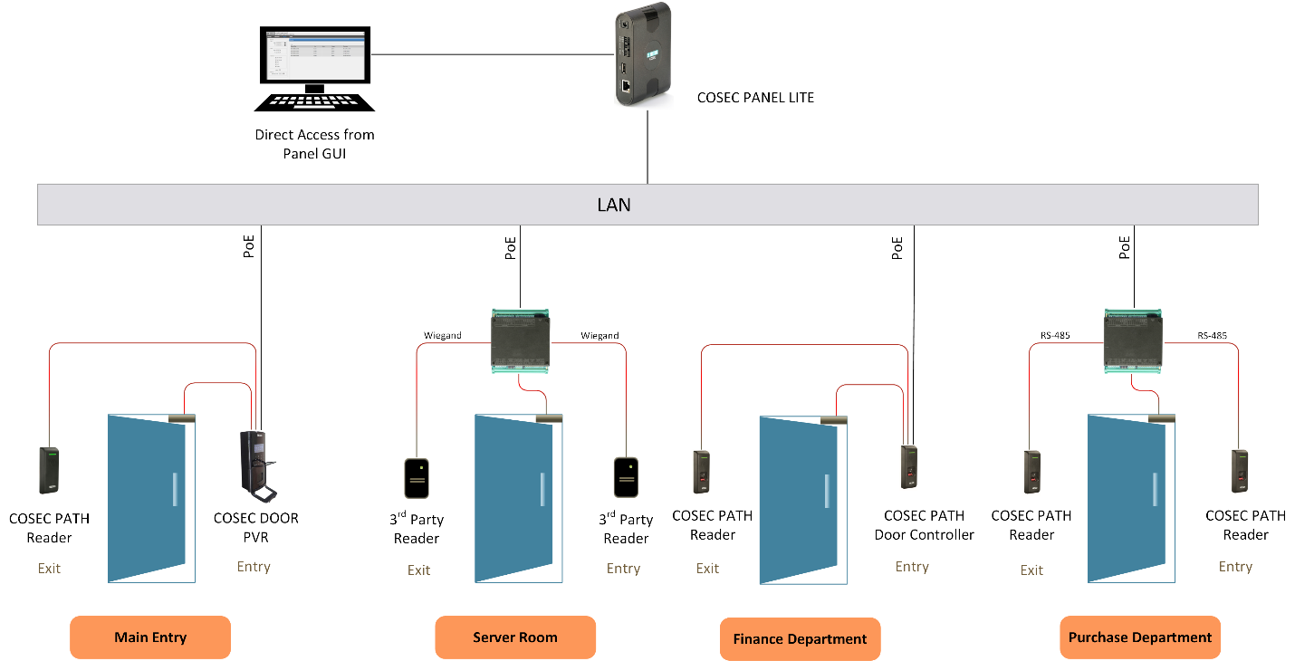
Access Control Architecture

Slide 49

COSEC Access Control Benefits
Scalable
Scalable in the Smallest Factor of One Door
Up to 255 Devices with PANEL LITE
Flexible
Install Near the Door
Reduce Complex Wiring
High Security
Biometric Palm Vein and Fingerprint Reader
Advance Access Control Features
Reliable
Single Independent Door with Distributed Architecture
Standard IP based Wiring
`
Eliminate Server Cost
Control 255 Devices without Installing any Server
Eliminate Server and Maintenance Cost

Slide 50
Matrix COSEC Readers

Slide 51

PATH Series - Exit Readers
COSEC PATH RDFE
COSEC PATH RDFM
COSEC PATH RDFI
COSEC PATH RDFP
COSEC PATH RDCE
COSEC PATH RDCM
COSEC PATH RDCI
Fingerprint and Card
RFID Card

Slide 52
Matrix COSEC PLATFORMs

Slide 53
Application Software PLATFORM
Web based Application Software
Controls up to 65,000 Door Controllers and 1 Million Users
Modular Architecture
SQL and Oracle Database Support
Real-time Monitoring and Control
COSEC CENTRA
COSEC PE
For 100 Users
COSEC GE
Up to 500 Users
COSEC ME
Up to 1000 Users
COSEC LE
Up to 1 Million Users

Slide 54
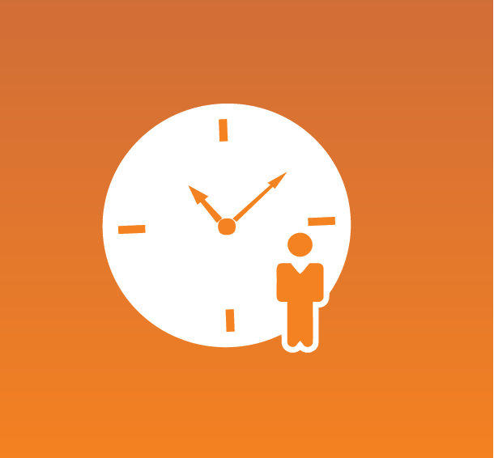





Add-On Software Modules

Slide 55
Time-Attendance

Slide 56
Why to Choose Matrix
Time-Attendance Solution?
Pay based on Actual Working Hours not Scheduled Time
Reduce HR Time by Avoiding Manual Attendance Management
Reduce Salary Bills by Calculating Actual Overtime Hours
Track Employee Movement and Handle Exception in Real-Time
Pay Salary on Time with Accurate and Fast Attendance Data and Payroll Integration

Slide 57
Matrix Time-Attendance Solution
will Fit for your Organizations if You…
Manually Enter Employee Time
Find Errors in Attendance Data
Need Centralized Attendance from Multi Locations
Track Movement of Field Employees
Manage Multiple Shifts and Schedules
Have Employees wise Different Attendance Policy
Using Payroll, ERP, HRMS for Salary Process
Want Real-Time Exception Data
Spend Much Time in Salary Processing

Slide 58
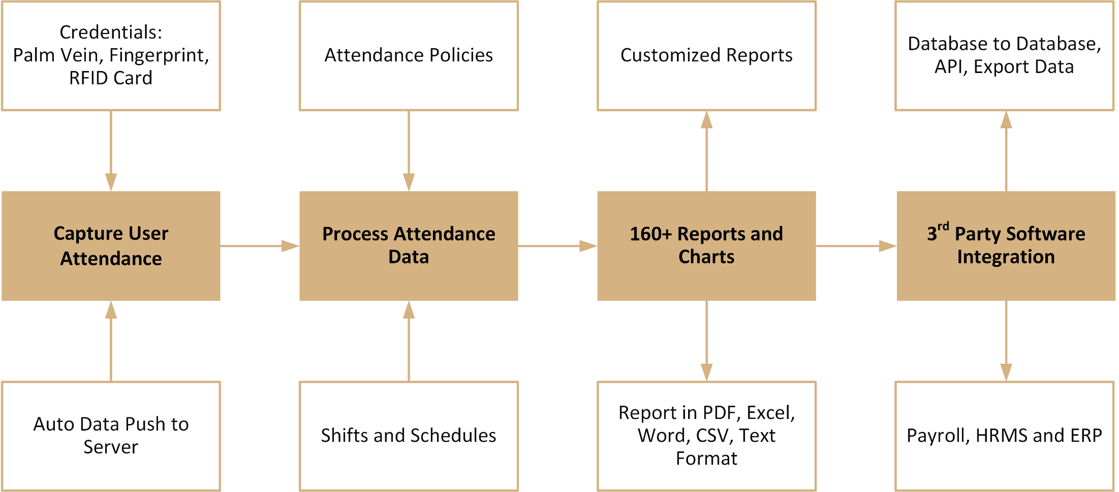
Time-Attendance Process

Slide 59
Time-Attendance Solution
Features | Advantages | Benefits
Automated, fool-proof attendance capturing from device | Real time data transfer to server | Eliminate leakages and improve accuracy and employee morale
Selectable entry-exit modes | Accurate monitoring of every entry and exit of every individual | Prevents misuse of policies to improve productivity
Flexible time-attendance policies, shifts, leave policies | Meets disparate needs of different functions, locations, departments | Reduces complexity in work hours calculations
E-mail and SMS notifications | Faster response to exceptional situations | Saves time of HR
Holidays and restricted holidays | 30 holiday schedule groups with 32 holidays in each group | Easy to define region wise holidays

Slide 60
Time-Attendance Solution
Features | Advantages | Benefits
Manual entries and corrections of entry-exit events | HR and admin need to spend time only on exceptions | Higher productivity and value-addition
Reports and charts | Ready-availability of accurate attendance data for salary processing | Timely salary payments, reduces errors, improves productivity and employee satisfaction
Integration with 3rd party application Software | Online and error-free data transfer | Seamless organization for better speed and control

Slide 61
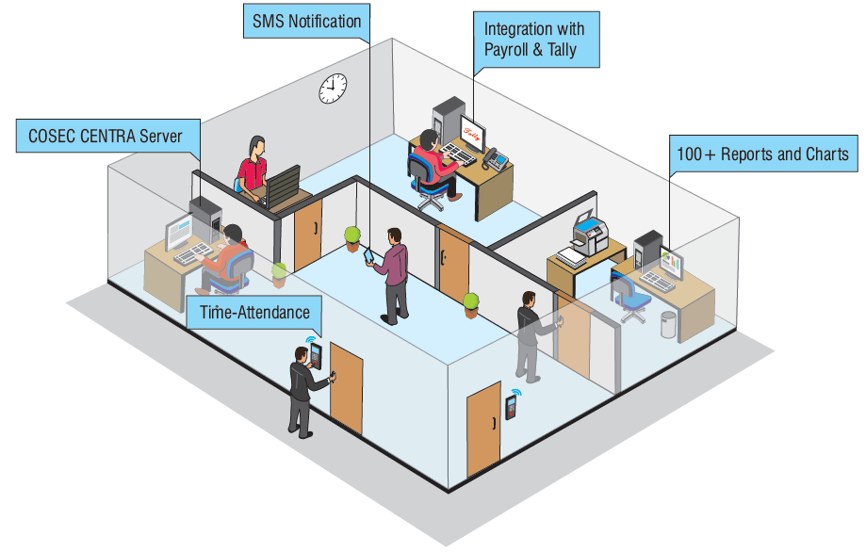
COSEC Time-Attendance Solution for a Single Location

Slide 62
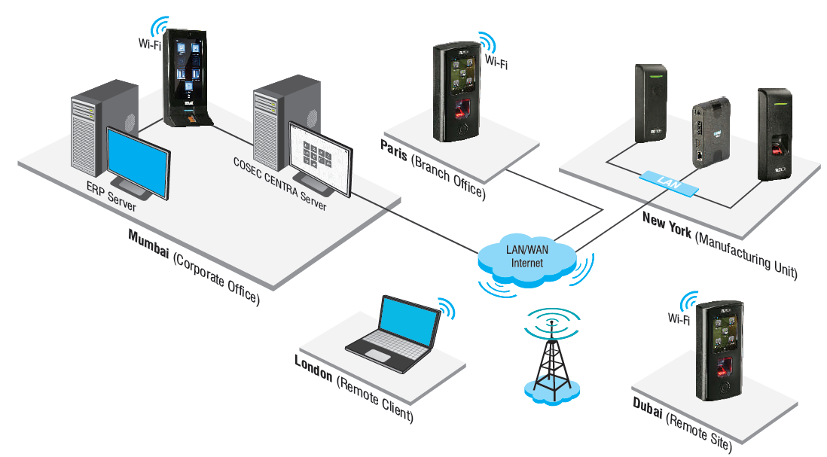
COSEC Time-Attendance Solution for Multi Location Enterprise

Slide 63
Employee Self Service Portal

Slide 64
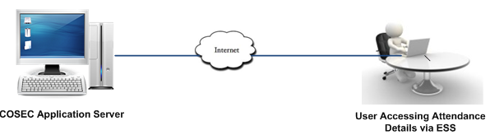
Employee Self Service for
For Employees:
View Attendance and Leave Details
Mark Attendance
View Shifts and Schedules
Visitor Pre-Registration
View Cafeteria Details
Apply for Leave/Tour
Apply for Attendance Correction
Edit Personal Information
For Reporting Officers:
Approve Leave/Tour Request
Approve Pre-Registration
Authorized Attendance
Plan Shifts and Schedules
View Team Attendance

Slide 65
Employee Self Service Portal
Features | Advantages | Benefits
Informative dashboard | Quick overview of an employee’s leave, attendance and shift details | Saves the time and boost productivity
Mark attendance | Mark attendance from anywhere using online portal | Reduces HR ‘s difficulties in maintain field employee’s attendance
View leave, attendance, shift and cafeteria details | Employee can have details as and when required | Improves employee’s time management and efficiency
Apply for leave/ tour/ attendance/ cafeteria correction | Eliminate paper work and long processes | Faster Process helps in improve productivity
Add/Edit Personal Details | HR can have error-free and updated database any time | Saves time

Slide 66
Employee Self Service Portal
Features | Advantages | Benefits
Virtual notice board | Update employees with the latest internal and external news and events | Easy to share information/news
Visitor pre-registration by host | Security and reception can use information to prepare a pass | Give a professional impression of the organization
Reporting officer self service | Create and manage shift schedules, approve leaves, authorize attendance and overtime/comp-off hours | Efficient team management

Slide 67

ESS is Available on

Slide 68
COSEC Mobile Application
Features | Advantages | Benefits
GPS based attendance marking | Easy to track field people | Better monitoring and planning
View leave, attendance, shift and cafeteria details | Employee can have details as and when required | Improves employee’s time management and efficiency
Approve leave/tour, attendance and cafeteria correction | Manager gets a notification on his mobile whenever any of his members applies | Faster response to exceptional situations
Add/Edit Personal Details | HR can have error-free and updated database any time | Saves time

Slide 69
Access Control

Slide 70
Why to Choose Matrix
Access Control Solution?
Restrict Unauthorized Access in Secured Area
User Access on Advance Biometric Technology
Restrict User Access based on User, Zone and Time
Require Advance Access Control Features
Centralized Monitoring and Control
Real-Time Notifications on Exception
Integrate with Video Surveillance and other Devices

Slide 71
Matrix Access Control Solution
will Fit for your Organizations if You…
Still Rely on Security Personal for Organization Security
Using Traditional RFID Card Solution
Using Access Control with Basic Features
Taking Actions After the Incident Happens
Managing Devices from Separate Locations
Want to Integrate Other Devices

Slide 72
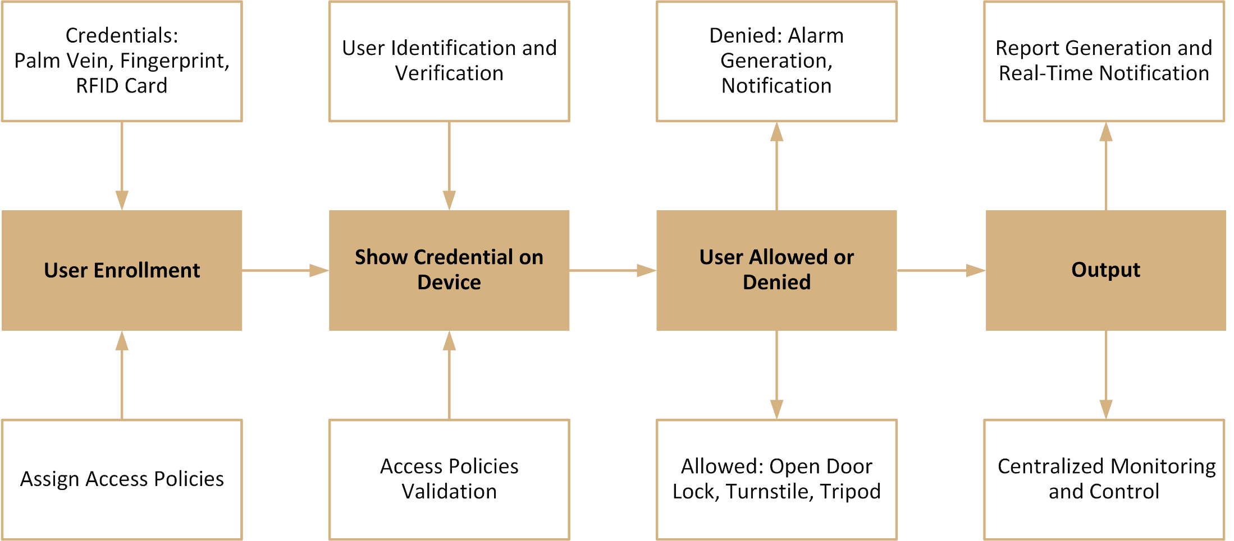
Access Control Process

Slide 73
Access Control Solution
Features | Advantages | Benefits
User, time and zone based access control | Control access by deciding who, where and when | Facilitate limited access
Create access zones by dividing organizations into departments | Employee of one department can be restricted from entering into another department | Stop employee roaming and leakages of information from department to department
Guard Tour | Facilitates enforcing vigil patrol of security guards | Immediate action can be taken on notification or alarm for any deviation
2-Person Rule | Allows entry when two persons from an authorized group jointly use their access rights within a specified time | Higher security to sensitive areas like locker, server room, r&d labs, etc.

Slide 74
Access Control Solution
Features | Advantages | Benefits
First-In User | Give access to users after designated person enters | Ensure higher level of safety and security
Smart Card based Identification | User’s fingerprint and other information are stored on the smart card instead of the device | Facilitate large number of users more than capacity of device
Anti-Pass back | Second entry using the same card is allowed only after an exit is registered for every entry | Prevents a card holder from passing his card back to another person to gain unauthorized entry
Man Trap | Two or more doors are arranged in a sequence which regulates traffic or control dust and heat | Prevents any intruder from entering or escaping in a hurry

Slide 75
Access Control Solution
Features | Advantages | Benefits
Centralized Monitoring and Control | Shows the current status of all the site controllers, door-controllers, alarms, In/Out ports | Live monitoring and control to check the system in real-time
Configurable Input and Output Ports and Linking | Integration of other hardware for further applications | Higher safety and security
Occupancy Control | Allows only defined number of people in zone | To limit the no. of people in areas like seminar halls, conference rooms and cafeterias
Route based Access | Ensures user reach to location in a particular sequence which is defined on his smart card | Prevents users to wander into premises intentionally or unknowingly

Slide 76
Visitor Management

Slide 77
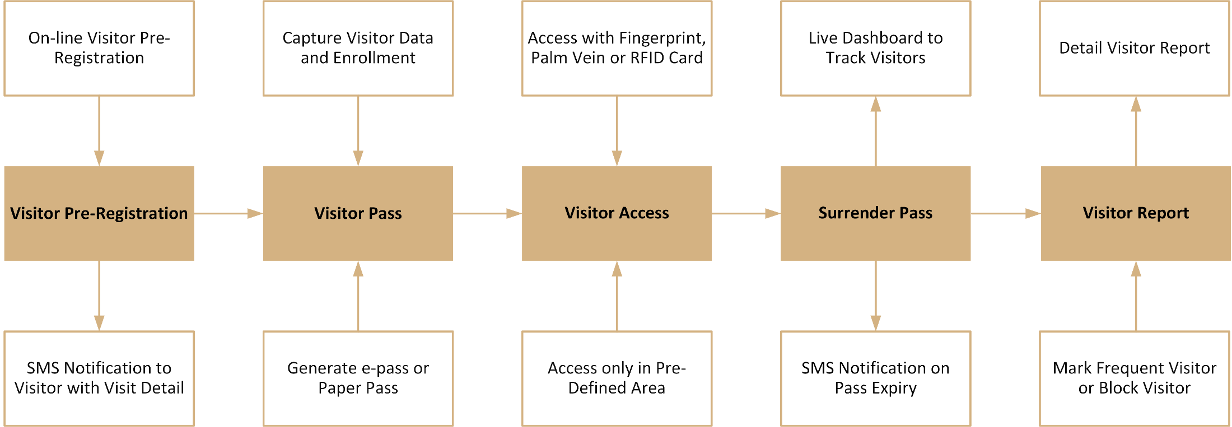
Visitor Management Process

Slide 78
Visitor Management Solution
Features | Advantages | Benefits
Visitor pre-registration | Faster check-in process of visitors | Saves precious time of everyone
Visitor database | Retrieve frequent visitors' details | Incident tracking, analysis and decision making
Visitor access rights | Enroll visitor’s fingerprint or RF card to permit access to selected areas only | Protection of valuable assets
Customized visitor pass | Create either an e-pass with access rights or a paper pass | Creates professional image of an organization
Send an SMS or email notification to the visitor and host | Quick check-in process when he arrives at the security gate | Saves time and boost productivity

Slide 79
Visitor Management Solution
Features | Advantages | Benefits
Manage visitor using online portal | Paper-less visitor management | Reduces cost and improves productivity
Frequent visitors | Pull up visitor information from the past records which eliminates the need for data re-entry | Boosts security person’s productivity
Visitor dashboard | Quick overview of all the visitors in a graphical format | Faster access of visitor information
Visitor reports | Reports in various file formats | For analysis and decision making

Slide 80
Cafeteria Management

Slide 81
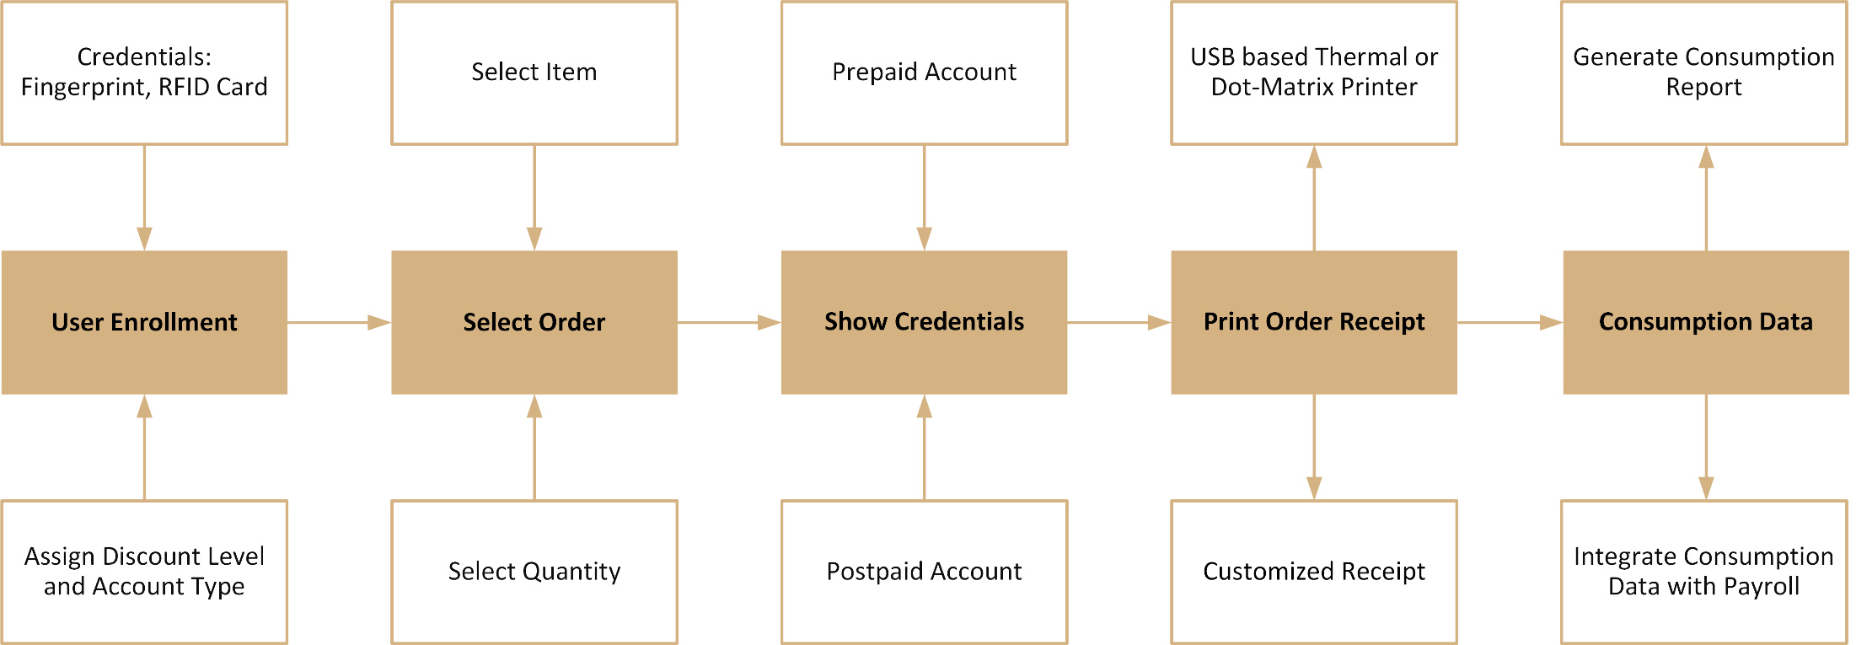
Cafeteria Management Process

Slide 82
Cafeteria Management Solution
Features | Advantages | Benefits
Create items and menu | Create up to 255 items and 9 different menus | Efficient cafeteria management
Menu schedule | Schedule and display different menus for specific dates, days and time | Easy to order from menu on display
Prepaid and postpaid user accounts | Cashless transactions | Accuracy and speed
Blocked users when consumption has exceeded their pre-fixed limits | Auto watch on users | Accurate calculation of consumption
Printer connectivity to generate food bill | Receipt for each user with transaction detail like items, rate and quantity | Faster bill payment

Slide 83
Cafeteria Management Solution
Features | Advantages | Benefits
Export data to 3rd party payroll and billing software | Avoids need for manual data entry or data transfer | Saves time and eliminate possibility of human errors and manipulation
Informative Reports | Item tracking to prevent wastage of food | Better food planning

Slide 84
Contract Workers Management

Slide 85
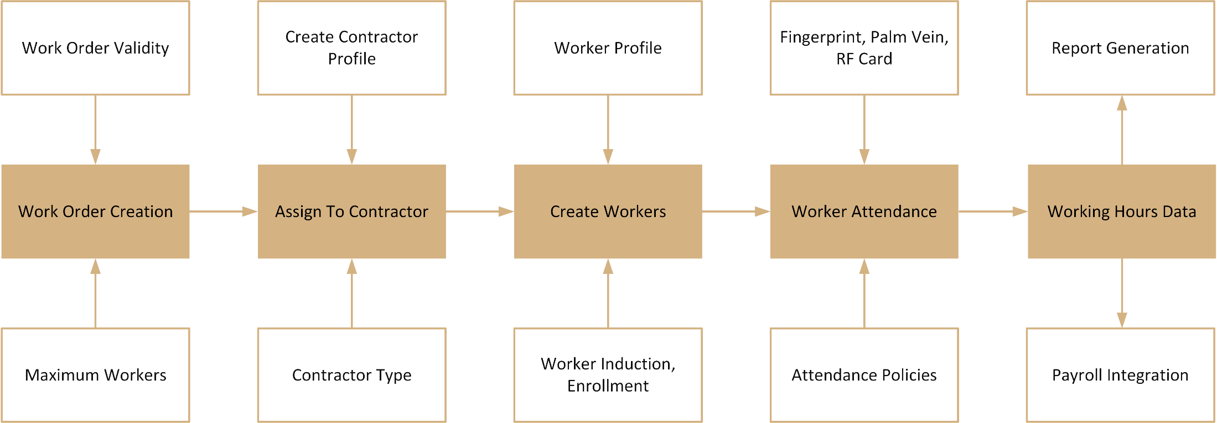
Contract Workers Management (CWM) Process

Slide 86
CWM Solution
Features | Advantages | Benefits
Creating work orders and assign them to contractors | Tracking Work Orders | Control Project Progress and Cost
Biometric and RF card based devices for attendance marking | Automated, Foolproof Attendance Capturing | Increase in Productivity and Minimize Overpayment
Flexible Time-Attendance Policies, Shifts, Overtime Policies | Meets Disparate Needs of Different Functions, Locations and Individuals | Faster time-attendance management helps in improve the productivity
Web based Contractor Portal | Update work order status, create new worker profile, report generation by contractors | Save time, Better Planning of Workers

Slide 87
CWM Solution
Features | Advantages | Benefits
Access control for workers | Prevents workers from entering unassigned areas and routes | Enhance security of the organization
Reports and charts | Export reports to various file formats like PDF, Excel, Word, RTF, CSV and TXT | Easy interpretation and decision making
E-mail and SMS notifications | Notifications on worker assignment, worker approval, worker entry/ exit, missing in/out punch | Faster response to exceptional situations
Integration with 3rd party applications | Database-database transfer, API and customized export templates integration methods | Seamless organization for better speed and control which prevents data-entry errors and saves time

Slide 88
Roster Management

Slide 89
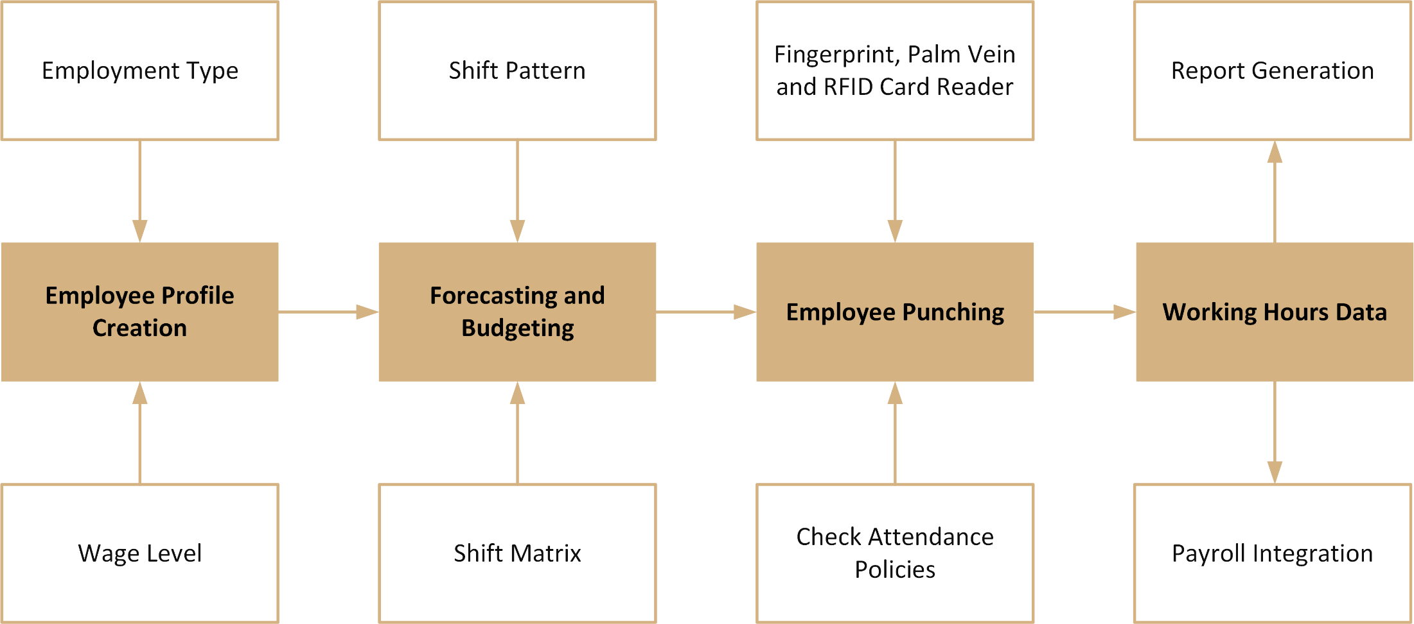
Roster Management Process

Slide 90
Roster Management Solution
Features | Advantages | Benefits
Employee profile creation | Manager can pull out this detail and get a report anytime from anywhere | Eliminate multiple spreadsheets and related confusions and chaos
Define attendance policies | Accurate attendance data at central place | Increase in productivity, discipline and morale
Auto roster creation | Generates a roster based on the schedule and forecast configured | Proper visibility of workload, availability and options
ESS access to users | Employees and managers both can view and update the details like attendance, shift, leave | Better planning and control
Notifications via SMS and E-mail | Notifications to employees on various events and reminders for shifts | Helps in reducing communication gaps

Slide 91
Roster Management Solution
Features | Advantages | Benefits
Shift pattern and shift matrix | Multiple shift and shift patterns | Saves manager’s time from routine work
Multi-week forecasting and budgeting | Helps managers in forecasting employee requirements and the cost | Better planning of project and cost control
Workforce analysis reports | Exclusive range of reports by applying various filters | Easy interpretation and decision making
Integration with 3rd party applications | Save a lot of time and prevent errors by eliminating manual data entry | Seamless organization for better speed and control
Shift pattern and shift matrix | Multiple shift and shift patterns | Saves manager’s time from routine work

Slide 92
Customer Case Study

Slide 93
Matrix COSEC @ Adani Enterprises Ltd
Applications:
Time-Attendance
Access Control
Workers Management Solution
Visitor Management Solution
Technology:
Biometric Fingerprint
Smart Card
Wireless Connectivity
Solutions Offered:
Real-Time Monitoring and Control
Integration with SAP
SMS and Email Notification
Integration with Boom-Barrier
Integration with Card Printing Software
Centralized Data Management
Route based Access Control
Smart Identification
Network Interface Failover
Matrix Offering:
Devices: 1200+
Users: 30,000+
Locations: India and Indonesia
Benefits:
Fool-Proof Security in Sensitive Areas
Proactive Access Control
Error Free Attendance Data

Slide 94
Matrix COSEC @ Sri Ram Finance
Applications:
Time-Attendance
Employee Self Service Portal
Technology:
Biometric Fingerprint based Devices
Solutions Offered:
Centralized Attendance Data
Real-Time Attendance Management
Integration with Payroll Software
Door Offline Notification
Attendance for Field Staff
Matrix Offering:
Devices: 700+
Users: 18,000+
Location: Across India
Benefits:
Error Free Attendance Data
Timely Salary Payment
Centralized Attendance Management

Slide 95
Matrix COSEC @ Aujan Industries Co
Applications:
Time-Attendance
Access Control
Employee Self Service Portal
Technology:
Biometric Palm Vein Controller
RFID Smart Card
Wireless Connectivity
Solutions Offered:
Accurate Overtime Report
Centralized Attendance Management
Integration with Turnstile in Factory
Accurate Attendance Data for Salary
Automatic Report Scheduler
Employee-wise Portal for Attendance
Fast and Accurate Palm Identification
Matrix Offering:
Devices: 20+
Users: 500+
Locations: KSA (HO and Factory) and Dubai
Benefits:
Restrict unauthorized Access in Manufacturing Unit
Error Free Attendance Data for Salary Processing
Accurate Overtime Payment

Slide 96
About Matrix

Slide 97




About Matrix
Established in 1994
250+ Security and Telecom Products
500+ Channel Partners
350,000+ Satisfied Customers
50+ Countries Reach
700+ Man-years of R&D Experience
ISO 9001-2008 Certified
Global Quality Certifications

Slide 98
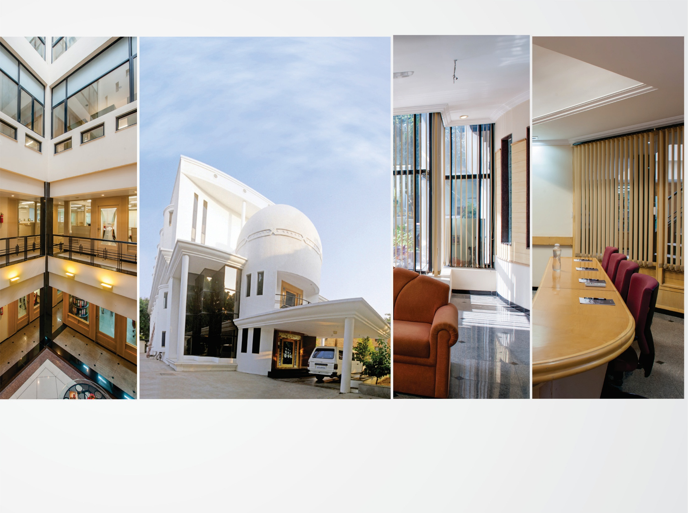
CORPORATE OFFICE
Based at Vadodara, Gujarat, India
Departments: Marketing, Sales, Product Management, Support, Finance, Customer Care, Purchase

Slide 99
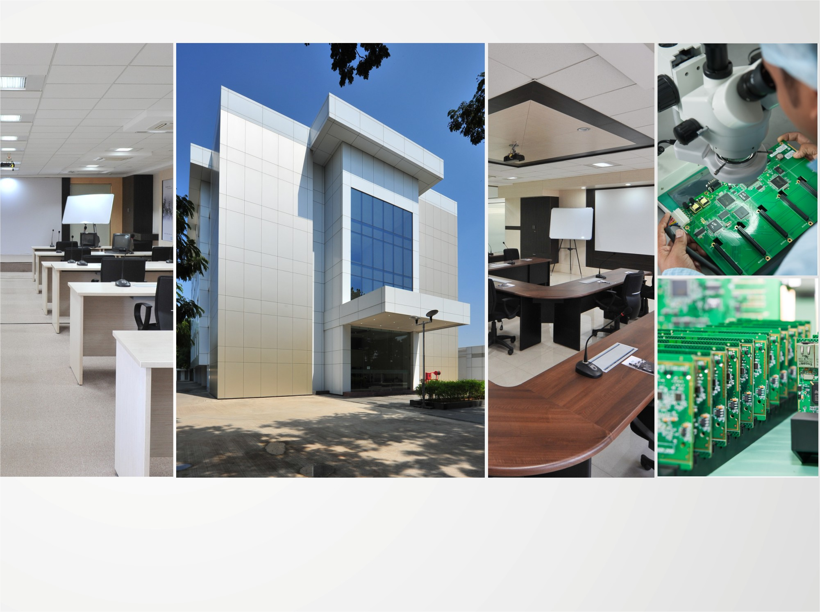
R&D CENTER
77,000 Sq.Ft
More than 40% Manpower in R&D, 700+ Man-years of R&D Experience
World-class Technology Platform and Processes

Slide 100
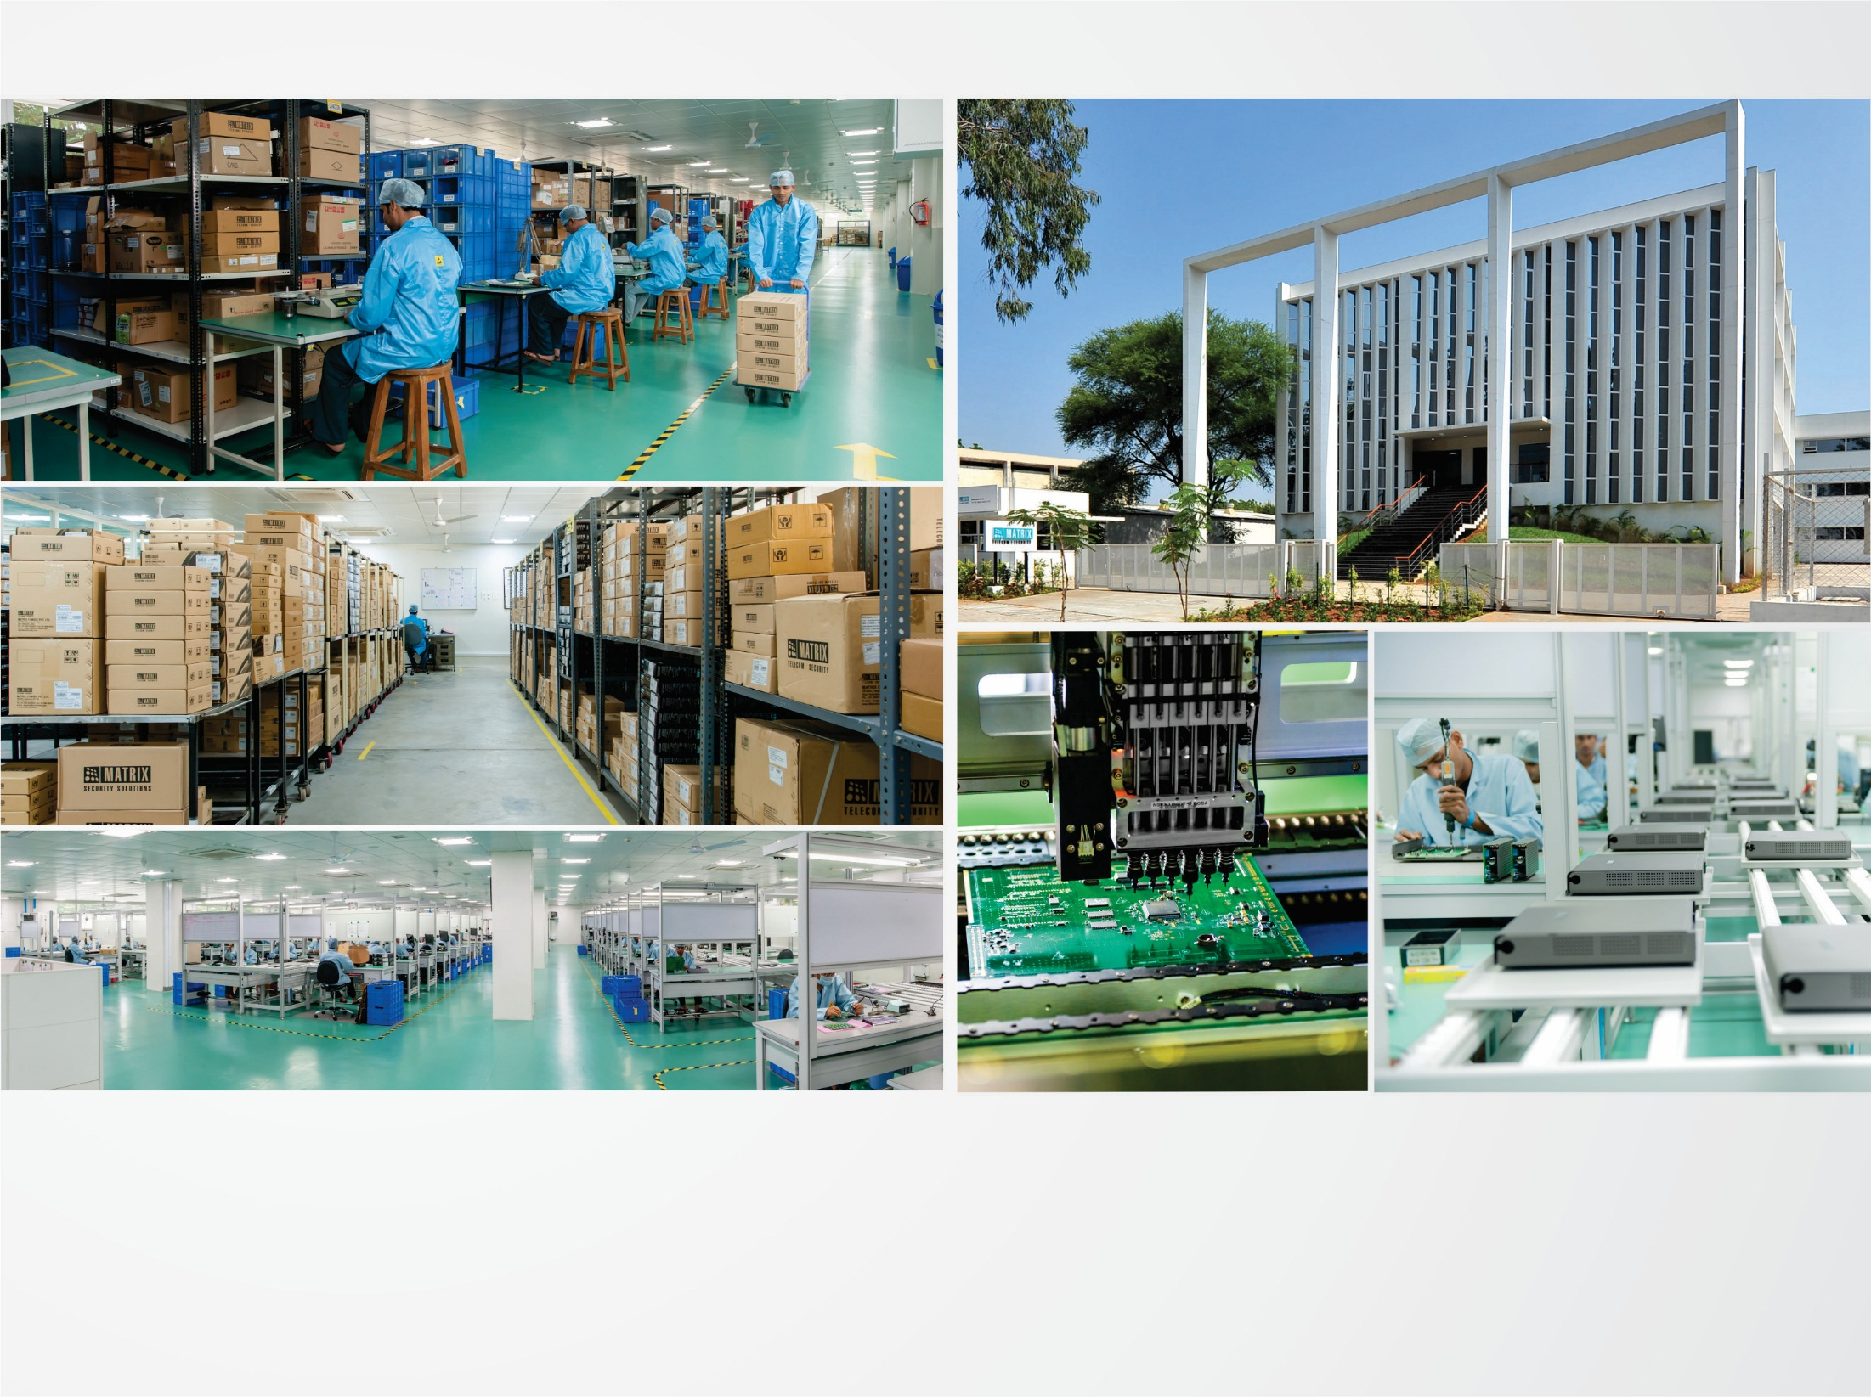
MANUFACTURING UNIT
73,000 Sq.Ft
100+ Work Stations
International Quality Systems and Processes

Slide 101
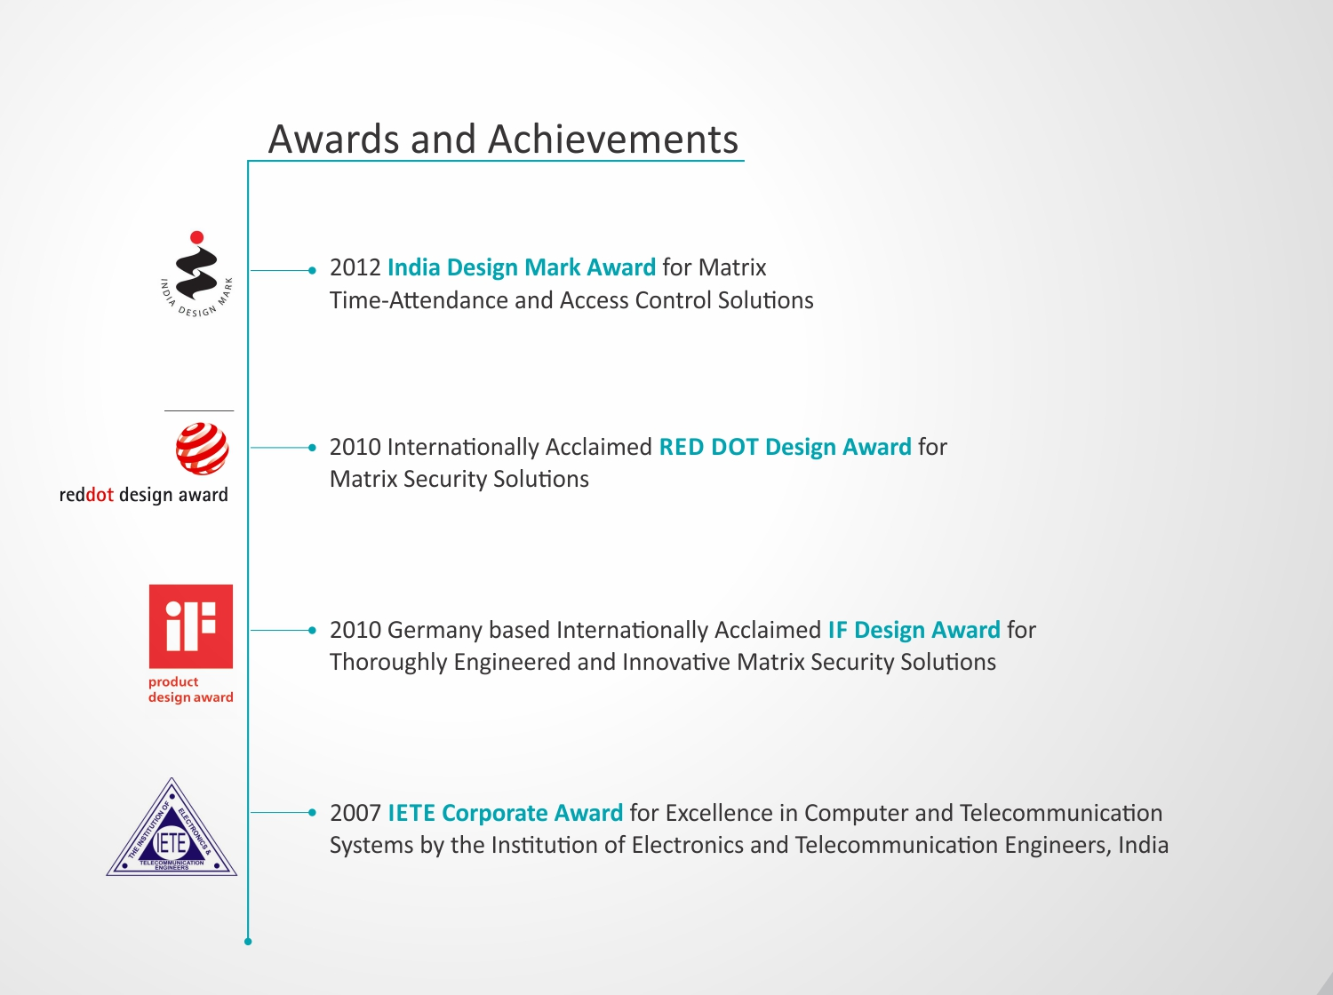

Slide 102


Slide 103
For Further information,
Please Contact
Email | More@MatrixComSec.com
Contact No | +91 265 2630555
Website | www.MatrixSecuSol.com
Address | 394-GIDC Makarpura, Vadodara-390010, Gujarat, India

Slide 104


